Slide 1
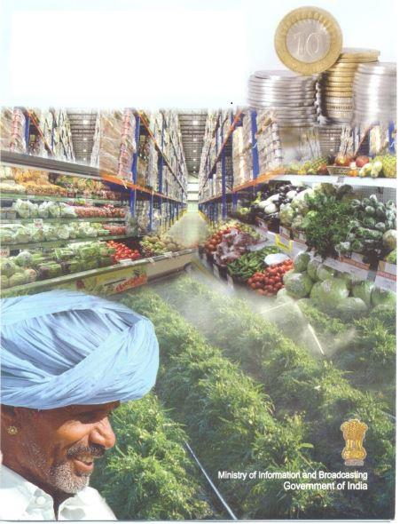
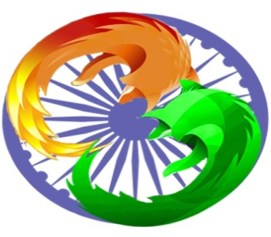
FDI IN RETAIL
INDUSTRY

Slide 2
CONTENTS:
WHAT IS FDI?
WHY COUNTRIES SEEK FDI?
GLOBAL RETAILING SCENARIO
FDI IN INDIAN RETAIL INDUSTRY
ADVANTAGES & DISADVANTAGES
CONCLUSION

Slide 3
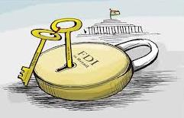
WHAT IS FDI?
FDI can be defined as a cross border investment, where foreign assets are invested into the organizations of the domestic market excluding the investment in stock.

Slide 4
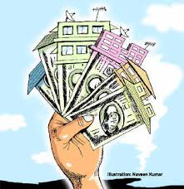
Why countries seek FDI?
Increase investment level and thereby income &
employment
Increase tax revenue of government
Facilitates transfer of technology
Encourage managerial revolution through professional management
Increase exports and reduce import requirements
Increase competition and break domestic monopolies
Improves quality and reduces cost of inputs

Slide 5
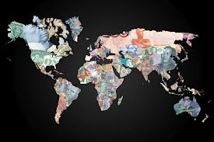
Global Retailing Scenario
The positive impact of organized retailing could be seen in USA, UK, and Mexico and also in China.
Retail is the second largest industry in US. It is also one of the largest employment generators.
It is also important to understand that Argentina, China, Brazil, Chile, Indonesia, Malaysia, Russia, Singapore and Thailand have allowed 100% FDI in multi brand retail.

Slide 6
Contd...
UNITED STATES:
The United States is the world’s largest recipient of FDI. U.S. FDI totaled $254 billion in 2012.
White House data reported in June 2011 found that a total of 5.7 million workers were employed at facilities highly dependent on foreign direct investors.
CHINA:
Reached $59.1 billion in the first six months of 2012, making China the largest recipient of foreign direct investment and topping the United States which had $57.4 billion of FDI.

Slide 7
Foreign Direct Investment – India vs China

Slide 8
Retail Industry
An Introduction
The Retail Industry is the sector of economy which is consisted of individuals, stores, commercial complexes, agencies, companies, and organizations, etc., involved in the business of selling or merchandizing diverse finished products or goods to the end-user consumers directly and indirectly. Goods and products of the retail industry or sector are the finished final objects/products of all sectors of commerce and economy of a country.

Slide 9
FDI in Indian Retail Industry
Asia’s third largest retail market after China and Japan.
Organized retailing is very virgin space in India of only 5%.
Current Retail sector have sales of around $500 billion.
Expected to have sales of $900 billion by 2014.
“It still far behind China, whose retail sales by 2014 is expected to cross $4500 billion mark.”

Slide 10
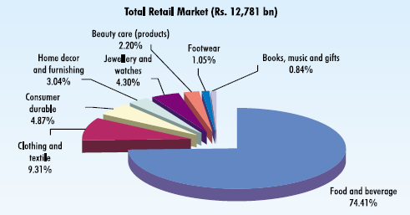
Retail Industry

Slide 11
Division of Retail Industry – Organised and Unorganised Retailing
The retail industry is mainly divided into:-
Unorganised Retailing
Unorganised retailing, on the other hand, refers to the traditional formats of low-cost retailing, for example, the local kirana shops, owner manned general stores, paan/beedi shops, convenience stores, hand cart and pavement vendors, etc.
Organised Retailing
Organised retailing refers to trading activities undertaken by licensed retailers, that is, those who are registered for sales tax, income tax, etc. These include the corporate-backed hypermarkets and retail chains, and also the privately owned large retail businesses.

Slide 12
Major Retailers in India
Pantaloon:
Pantaloon is one of the biggest retailers in India with more than 450 stores across the country. Headquartered in Mumbai, it has more than 5 million sq. ft retail space located across the country. It's growing at an enviable pace and is expected to reach 30 million sq. ft by the year 2010. In 2001, Pantaloon launched country's first hypermarket ‘Big Bazaar’.

Slide 13
Major Retailers in India
Pantaloon:
It has the following retail segments:
Food & Grocery: Big Bazaar, Food Bazaar
Home Solutions: Hometown, Furniture Bazaar, Collection-i
Consumer Electronics: e-zone
Shoes: Shoe Factory
Books, Music & Gifts: Depot
Health & Beauty Care: Star, Sitara
E-tailing: Futurebazaar.com
Entertainment: Bowling Co.

Slide 14
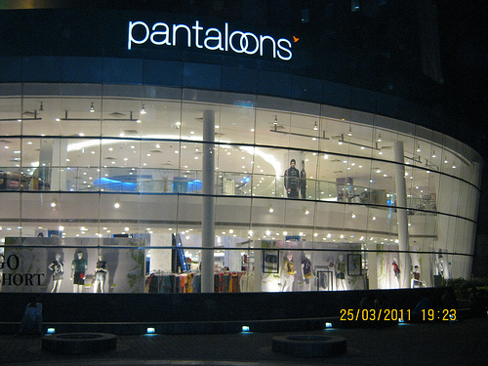
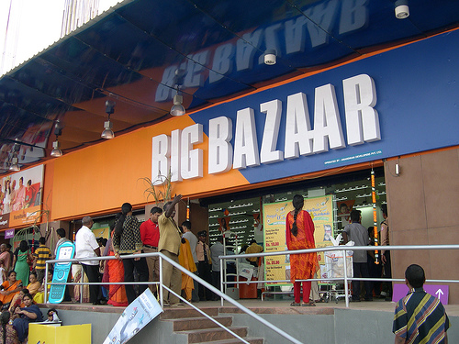
Major Retailers in India

Slide 15
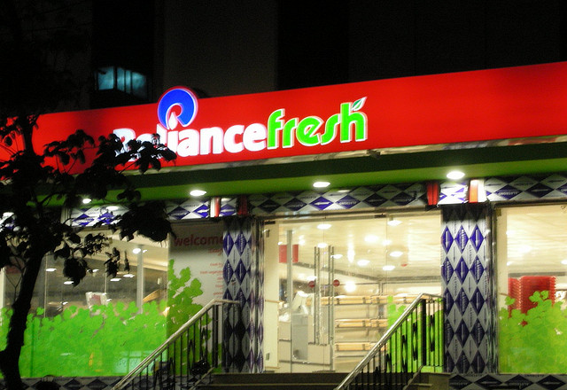
Major Retailers in India

Slide 16
Major Retailers in India

Slide 17
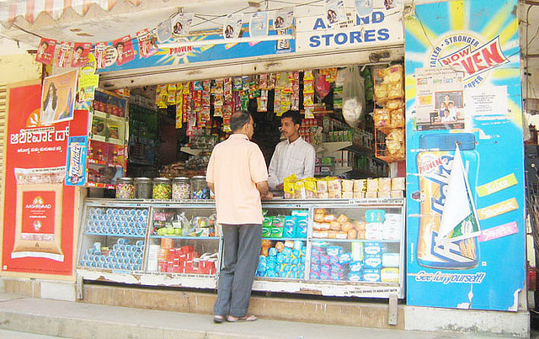
Retail formats in India
Mom-and-pop stores (Kirana store):
They are family owned business catering to small sections; they are individually handled retail outlets and have a personal touch.

Slide 18
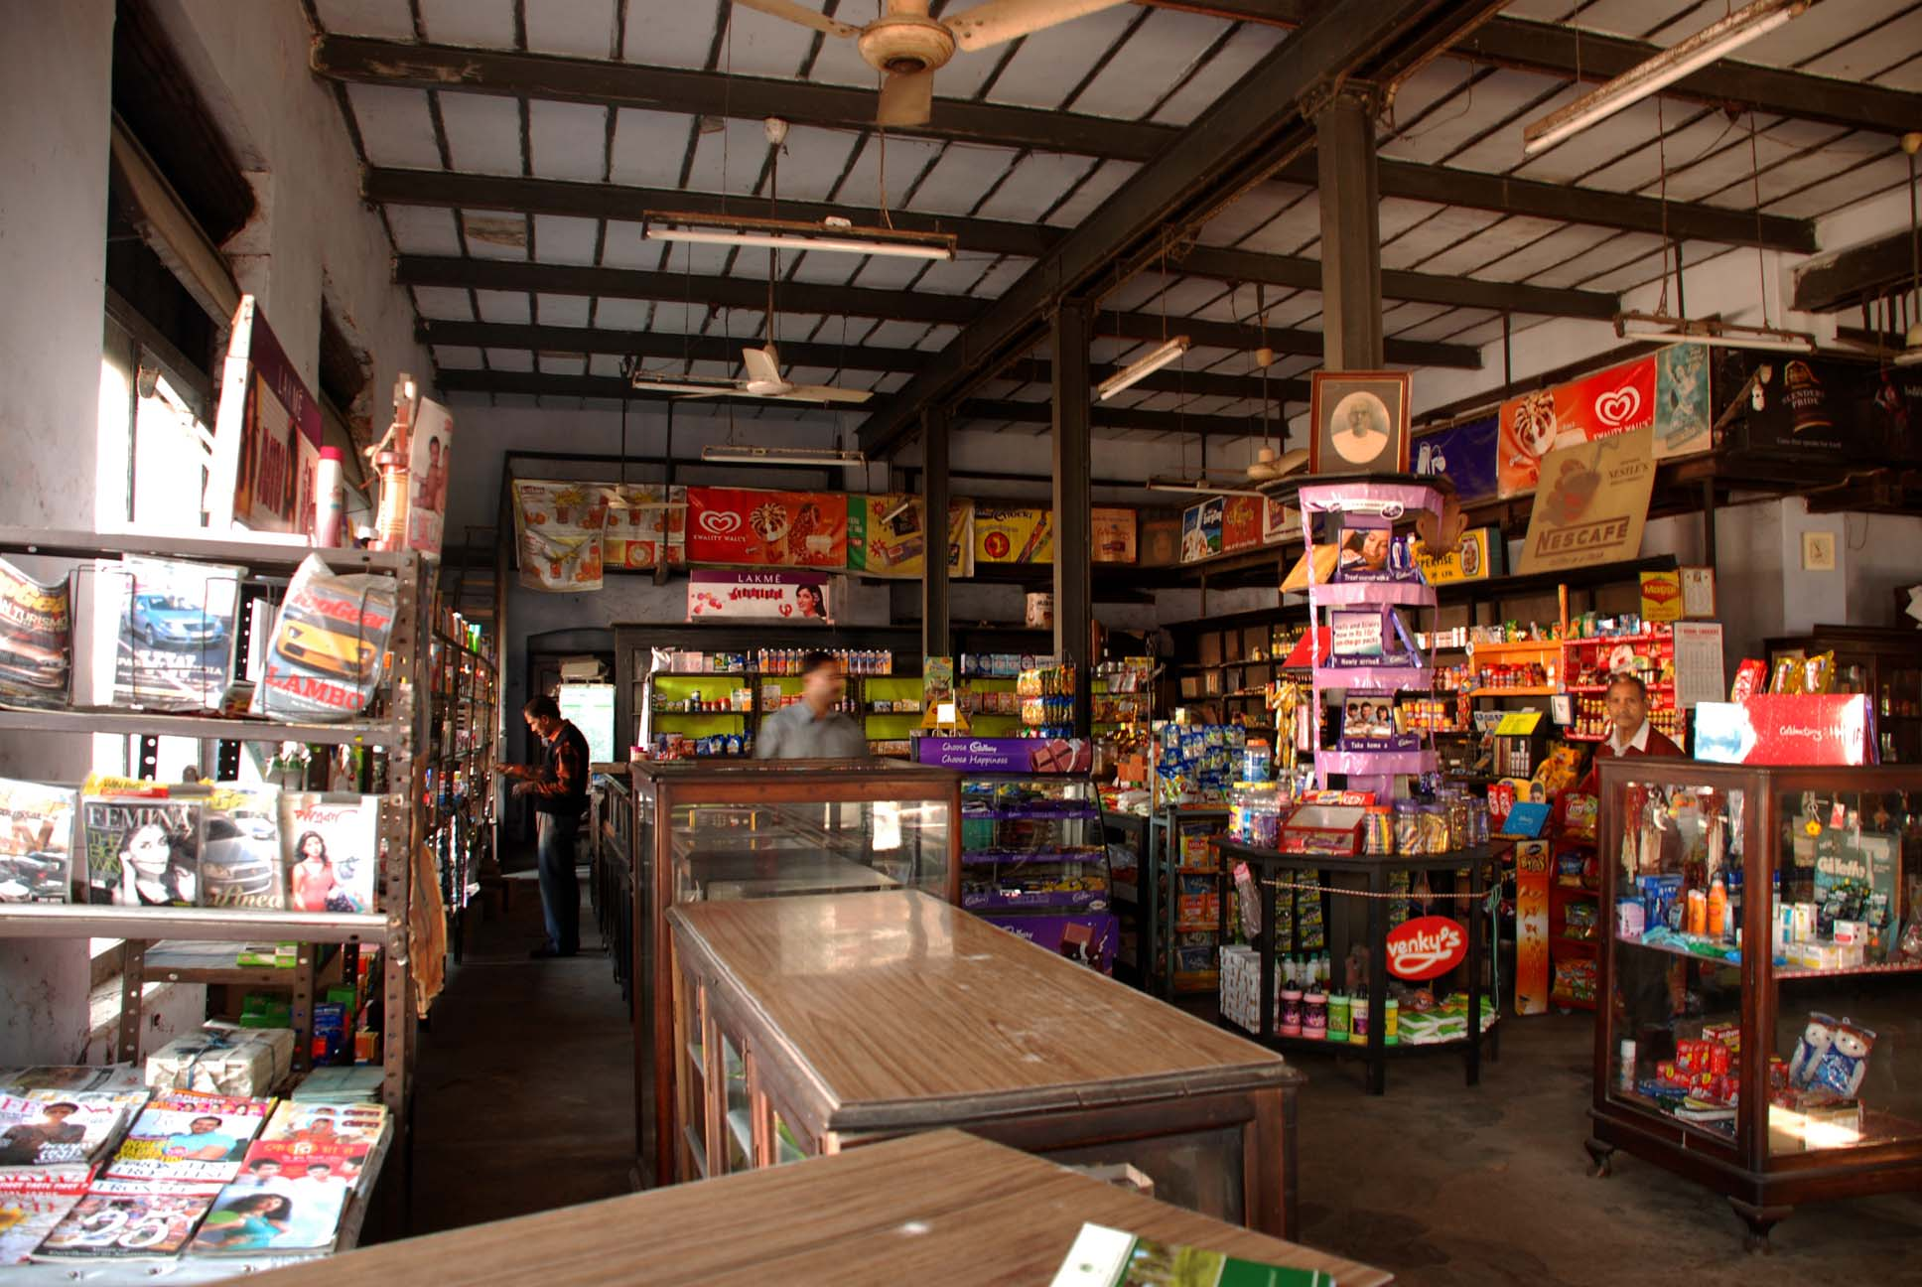
Retail formats in India
Departmental stores:
These are general retail merchandisers offering quality products and services.

Slide 19
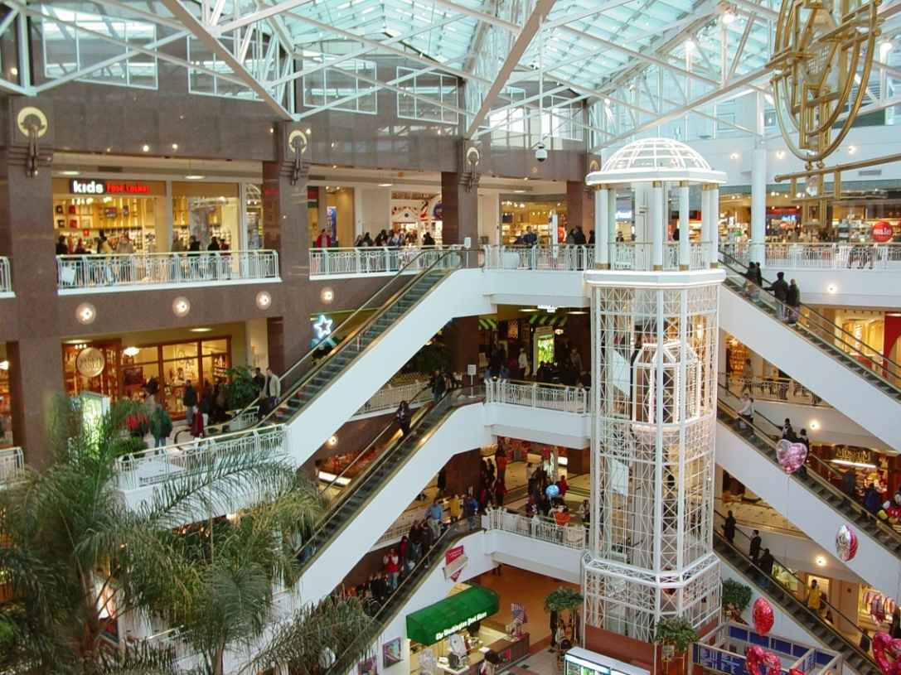
Retail formats in India
Shopping malls:
The biggest form of retail in India, malls offers customers a mix of all types of products and services including entertainment and food under a single roof.

Slide 20
Retail formats in India
E-traders:
Are retailers providing online buying and selling of products and services.
YES........

Slide 21
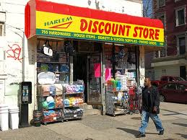
Retail formats in India
Discount stores:
These are factory outlets that give discount on the MRP.

Slide 22
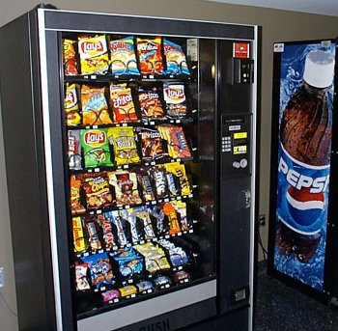
Retail formats in India
Vending:
It is a relatively new entry, in the retail sector. Here beverages, snacks and other small items can be bought via vending machine.

Slide 23
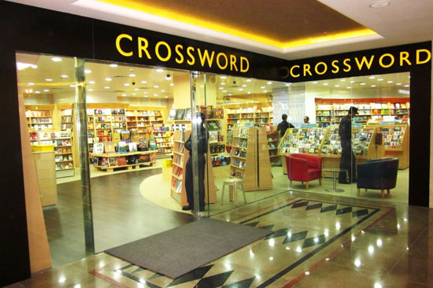
Retail formats in India
Specialty stores:
These are retail chains dealing in specific categories and provide deep assortment. Mumbai's Crossword Book Store and RPG's Music World are a couple of examples.

Slide 24
Differences in single brand retail and multi brand retail:
Single Brand Retail:
Nike Company opens outlets in Ahmadabad, Bangalore, Delhi and Mumbai selling nothing but Nike Shoes, Nike wrist-watches and Nike t-shirts only.
This is single brand retail.
FDI in Single-Brand Retailing was permitted in 2006, to the extent of 51%.
These were mostly outlets for sportswear, luxury goods, apparel, fashion clothing, jewellery, hand bags, life-style products.
But neither the Political parties nor Local Kiranawala raised any voice against this, why?
Because these are ‘high-end’ luxury items for brand conscious upper middle class and rich class people. It doesn’t hurt population at large. It was not like people would stop purchasing from local garment store to get Nike or Adidas.

Slide 25
Multi Brand Retail:
Big Bazaar opens mall in above cities: selling t-shirts of multiple-brands such as Reebok, Nike, Adidas, Allen Solley, Van Huesen, Peter England etc. +and+ they also sell unbranded t-shirts (you know those buy one get three t-shirts free from unknown companies.)
So this is multi-brand retail: when an outlet sells a product (tshirt, tie, shoes anything) of more than one brand.

Slide 26
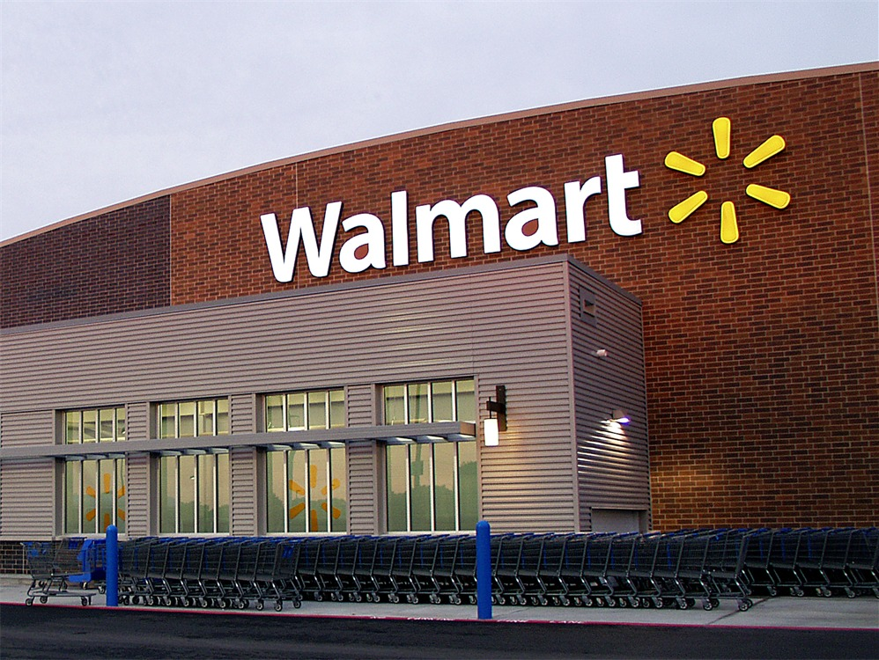
Major Players in the International Market:

Slide 27
Major Players in the International Market:
Wal-Mart:
Wal-mart is an American multinational retailer corporation that runs chains of large discount department stores and warehouse stores. The company is the world's third largest public corporation, according to the Fortune Global 500 list in 2012. It is also the biggest private employer in the world with over two million employees, and is the largest retailer in the world. Bharti Wal-Mart Private Limited is a joint venture between Bharti Enterprises, one of India's leading business groups with interests in telecom, agri-business, insurance and retail, and Wal-Mart, the world’s leading retailer, renowned for its efficiency and expertise in logistics, supply chain management and sourcing.
The joint venture is establishing wholesale cash-and carries stores and back-end supply chain management operations in line with Government of India guidelines. Under the agreement, Bharti and Wal-Mart hold 50:50 stakes in Bharti Wal-Mart Private Limited.

Slide 28
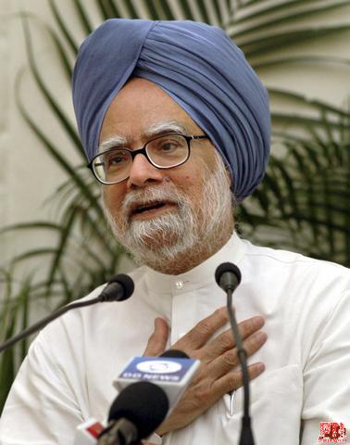
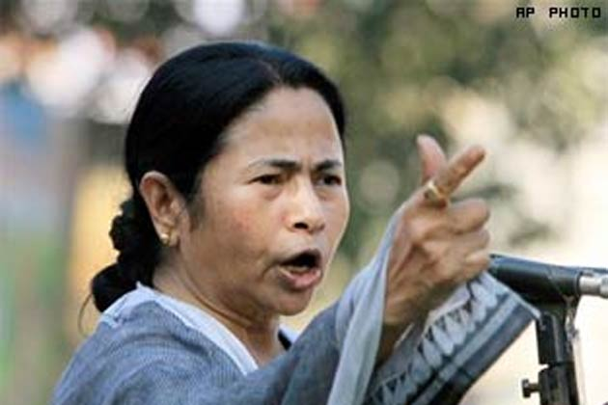
Political Developments:

Slide 29
Political Developments:
In less than 24 hours, the government announced more measures to liberalize the economy than in the past eight years.
The government made a decision to allow foreign direct investment from abroad of up to 51 percent in multi-brand supermarkets, up to 49 percent in aviation, up to 71 percent in broadcasting and up to 49 percent in parts of the power industry.
Dr. Manmohan Singh has cleverly sidestepped opposition parties and waspish allies this time by leaving it to individual states to decide whether to allow the supermarkets on their patch.

Slide 30
Impact of FDI : Different points of view
Government Argument
Huge investments in the retail sector will see gainful employment opportunities in agro-processing, sorting, marketing, logistics management and front-end retail.
At least 10 million jobs will be created in the next three years in the retail sector.
FDI in retail will help farmers secure remunerative prices by eliminating exploitative middlemen.
Foreign retail majors will ensure effective supply-chain efficiencies. That will also create an opportunity for the local players in retail to learn from them.

Slide 31
Government Policies:
Background:
1995 – World Trade Organization’s general agreement on trade in services, which include both wholesale and retailing services, came into effect
1997 – FDI in cash and carry (wholesale) with 100% rights allowed under the government approval route
2006 – FDI in cash and carry (wholesale) brought under the automatic route
Up-to 51% investment in a single- brand retail outlet permitted
2011 – 100% FDI in single –brand retail permitted
2012, Sep – 51% FDI in multi- brand retail permitted

Slide 32
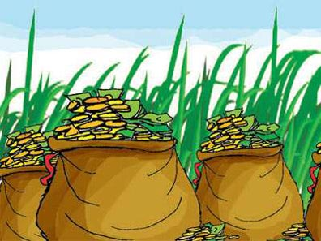
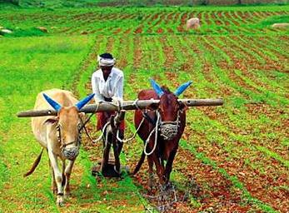
HOW FARMERS GET BENIFITED?
Farmers get greater share of consumer’s pay,
Retailers directly source goods from farmers,
Integrating Indian farmers in
Global Supply-Chain.

Slide 33
Impact of FDI : Different points of view
Benefit to farmers:
7-10% higher price to farmers than what they get from Mandi
3-4% incentive for the quality of the produce farmers deliver to Bharti Wal-Mart based on customer requirement
Expert advice on better crop planning and management
Efficient crop calendar management aimed at catching early and late seasons for better prices
Opportunity to maximize and improve income by offering better quality

Slide 34
Impact of FDI : Different points of view

Slide 35
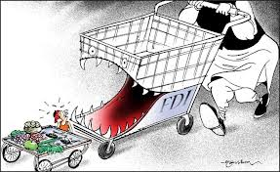
Negative Impacts
It will be a trouble for the small shopkeepers and small retailers in the market for only certain period of time.

Slide 36
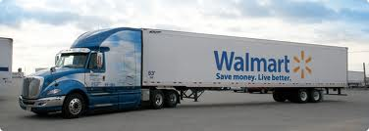
Advancement of Technology
Wastage and Storage problems will be resolved,
Efficient logistics, production, and distribution channels,
Digital records, Infrastructure
Distribution and warehousing technologies.

Slide 37
Opportunity for Employment
Creating at least 10 million jobs in
Agro-processing,
Manufacturing,
Logistics.
Improvement in the quality of employment,
Estimating 50% of jobs in rural areas,
30% of inputs from Medium-size & Small enterprises.

Slide 38
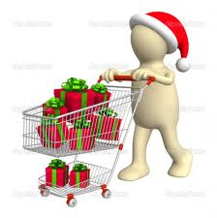
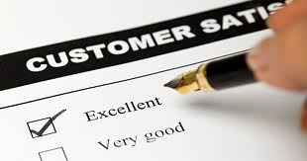
Satisfied Consumers
Safety & quality,
High shopping experience,
Upgradation of lifestyle & fashion of people,
Awareness of International Brands.

Slide 39
“There was a time when even the entry of computers was resisted in the belief that it would lead to a loss of jobs. If FDI can unleash the true potential of agricultural value chain, we must welcome it. As far as the kirana store is concerned, let us not underestimate Indian ingenuity. Wal-mart can co-exist with the small shop, each adding to customer choice.”
Sunil Mittal, MD, Bharti Enterprises

Slide 40
CONCLUSION
In principle, governments should not prevent anybody, Indian or foreign, from setting up any business unless there are very good reasons to do so. Hence, unless it can be shown that FDI in retail will do more harm than good for the economy, it should be allowed.
Fears of small shopkeepers getting displaced are vastly exaggerated. When domestic majors were allowed to invest in retail, both supermarket chains and neighbourhood pop-and-mom stores coexisted. It's not going to be any different when FDI in retail is allowed. Who, after all, will give home delivery? The local kirana. Why would anyone shun them?
All this promises to make the Indian retail market a real happening place in the days ahead while at the same time offering immense business opportunities to the domestic entrepreneurs. In fact, this is likely to transform the whole contours of the India market, making it a part of the overall global market.

Slide 41
THANK YOU

